Slide 1
2nd session.
The entrepreneur. Its role in society, features and profile.

Slide 2
The entrepreneurial team
Key aspect
“It is better to have a B idea with an A team than an A idea with a B team”
Multidisciplinary
Expertise in the activity
Notes:
Having the idea, being sure that it suits the market, designing a plan to reach the market, analysing how to produce the product or designing and providing services is not enough. What about people? Think and define seriously which will be the key management team or, otherwise think about the characteristics of the team we have, we can develop the idea about original business. Emphasize a lot this part. Nowadays, it is the human capital time.

Slide 3
Innovative Reliable Business Idea (I.R.B.I.)
Name of the company,
Brief description,
Features and profiles of the enterpreneurs,
Client-product binomy, BM Canvas
Source of Innovation, why it is innovative,
Porter Analysis,
S.W.O.T. Analysis
Vision, Mission,
Competitive advantages,
Notes:
Finally, when you search investors, you should summarize the financial plan getting some concrete and argued requests, and include this briefing inside the financial plan.

Slide 4
Entrepreneur profile (1)
Push and active
  He starts alone or in a small team without waiting any signals or instructions
  He works actively quite a lot
  He sleeps less than usual
Self-confidence
  He believes in his possibilities
  He believes in having control over his own life
Notes:
It is a fundamental figure. Not everybody is suitable for it, but there are much more suitable people than you probably expect. Key characteristics.

Slide 5
Entrepreneur profile (2)
Long-term commitment
  Used to goals which are distant in time
  Total immersion and concentration
  He does not expect short-term acknowledgement
Money as success metric
  Understands money as a metric of success more than a way to get luxury or power
Notes:
It is a fundamental figure. Not everybody is suitable for it, but there are much more suitable people than you probably expect. Key characteristics.

Slide 6
Entrepreneur profile (3)
Persistent problem solving
  Intense desire to solve problems
  Strong determination to finish work
Goals determination
  Ability to set realistic and feasible goals, yet difficult to achieve
  Strong commitment to achieve them
Notes:
It is a fundamental figure. Not everybody is suitable for it, but there are much more suitable people than you probably expect. Key characteristics.

Slide 7
Entrepreneur profile (4)
Moderate risks acceptance
  Calculated risks but not betting
  Challenges over security
  Reasonable success probability
Ability to deal with failure
  Might be disappointed but not demoralized
  Learns about his own failures
  Determines precisely his own errors
Notes:
It is a fundamental figure. Not everybody is suitable for it, but there are much more suitable people than you probably expect. Key characteristics.

Slide 8
Entrepreneur profile (5)
Use of feedback
  He searches it actively
  He uses it to improve
  (Control vs. measure)
Takes initiatives and responsibilities
  He searches and takes initiatives
  Takes a position of personal responsibility
  Direct responsible of success or failure
Notes:
It is a fundamental figure. Not everybody is suitable for it, but there are much more suitable people than you probably expect. Key characteristics.

Slide 9
Entrepreneur profile (6)
Use of resources
  Searches experience and help (but not necessarily advice)
  Does not get involved in a way which prevents accepting help
Competition against auto-imposed goals
  He sets personal and short-term goals
  Difficult but realistic goals
  Competes against himself. Self-demanding
Notes:
It is a fundamental figure. Not everybody is suitable for it, but there are much more suitable people than you probably expect. Key characteristics.

Slide 10
Entrepreneur profile (7)
Own fate control
  He believes that his control on what happens is more important that factors such as luck or external circumstances
Tolerance of uncertainty
  He withstands well uncertainty in his job
  He does not need security in his job
Notes:
It is a fundamental figure. Not everybody is suitable for it, but there are much more suitable people than you probably expect. Key characteristics.

Slide 11
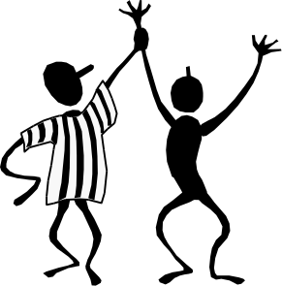
Quality of the decisions (the 4 E’s)
In order to guarantee his future, an entrepreneur must know:
QUALITY OF THE DECISIONS
( THE 4E’S )
To make good decisions is the basis of the future development of any business.
These decisions will be shared, if possible, and they will respond to a complementation of the personality of the individuals
Nobody can say that he alone knows more than a team of prepared and trained people. To have a wider vision of the horizon due to be in a higher position just implies dominating the whole vision, but this never implies having a total knowledge.
To guarantee the success and be able to reach business excellence, a properly leaded team capable of taking the best quality decisions is needed.
Notes:
Comment this aspect about decision making and its shared and complementary characteristic.

Slide 12
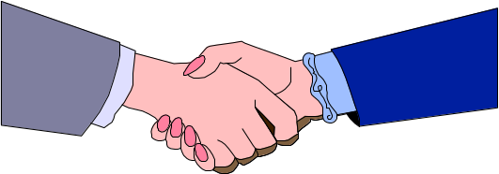
Quality of the decisions (the 4 E’s)
Management functions
E1 EFFECTIVENESS
E₂ EFFICIENCY
E₃ ENTERPRISE INNOVATION
E₄ TEAM
E₁ + E₂ = To ensure SHORT TERM EFFECTIVENESS AND EFFICIENCY.
E₃ + E₄ = To ensure LONG TERM VIABILITY and STABILITY, adaptation to the environment and clients needs.
E₁ + E₂ +E₃ + E₄ = PROFIT
Notes:
Good management is that one which have enough 4 E’s elements. A team must have enough qualities from each one of the E’s in order to be balanced and effective. The project leader must also have some balanced qualities but E1 and E3 have more importance, normally.

